Slide 1
COUNSELLING SESSION
TOPIC: COPING STRATGIES FOR COLLEGE STUDENTS IN THE PRESENT SCENARIO
Presented By:
Dr Shama Hamdani
Consultant Clinical Psychologist

Slide 2
Introduction
COVID-19 has drastically changed the lives of millions around the world, including college students by putting significant stress on them, their dreams are becoming nightmares.
Lockdown is the only option available to slowdown the rate of spreading the infection.
In this process, all the education institutes were also locked down all of sudden.
The students were in different phases of their academic year like some are about to complete the academic year, some are about to write their entrance examinations and some are writing their examinations.

Slide 3
Issues Faced by College Students
Uncertainty & Helplessness
Health concerns
Quarantine
Social Disconnect/Loneliness
Financial implications
Change in lifestyles
Unable to access online education

Slide 4
Excessive use of Online Games
Anger & Frustration
Anxiety
Sleep difficulties
Distress-related social media
Fear of acquiring COVID-19 infection

Slide 5
Screen Addiction
Nightmares
Self-harming Behavior
Substance Abuse
Suicidal Ideations & Attempts
Increased Suicide Rates

Slide 6
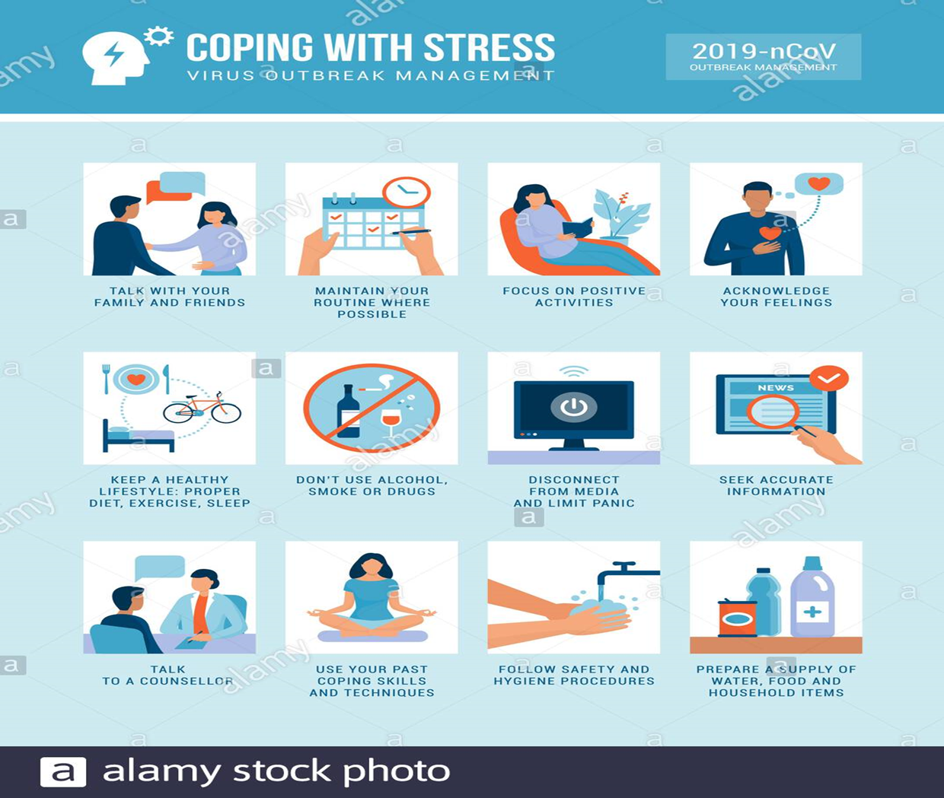
Coping Techniques for Students

Slide 7
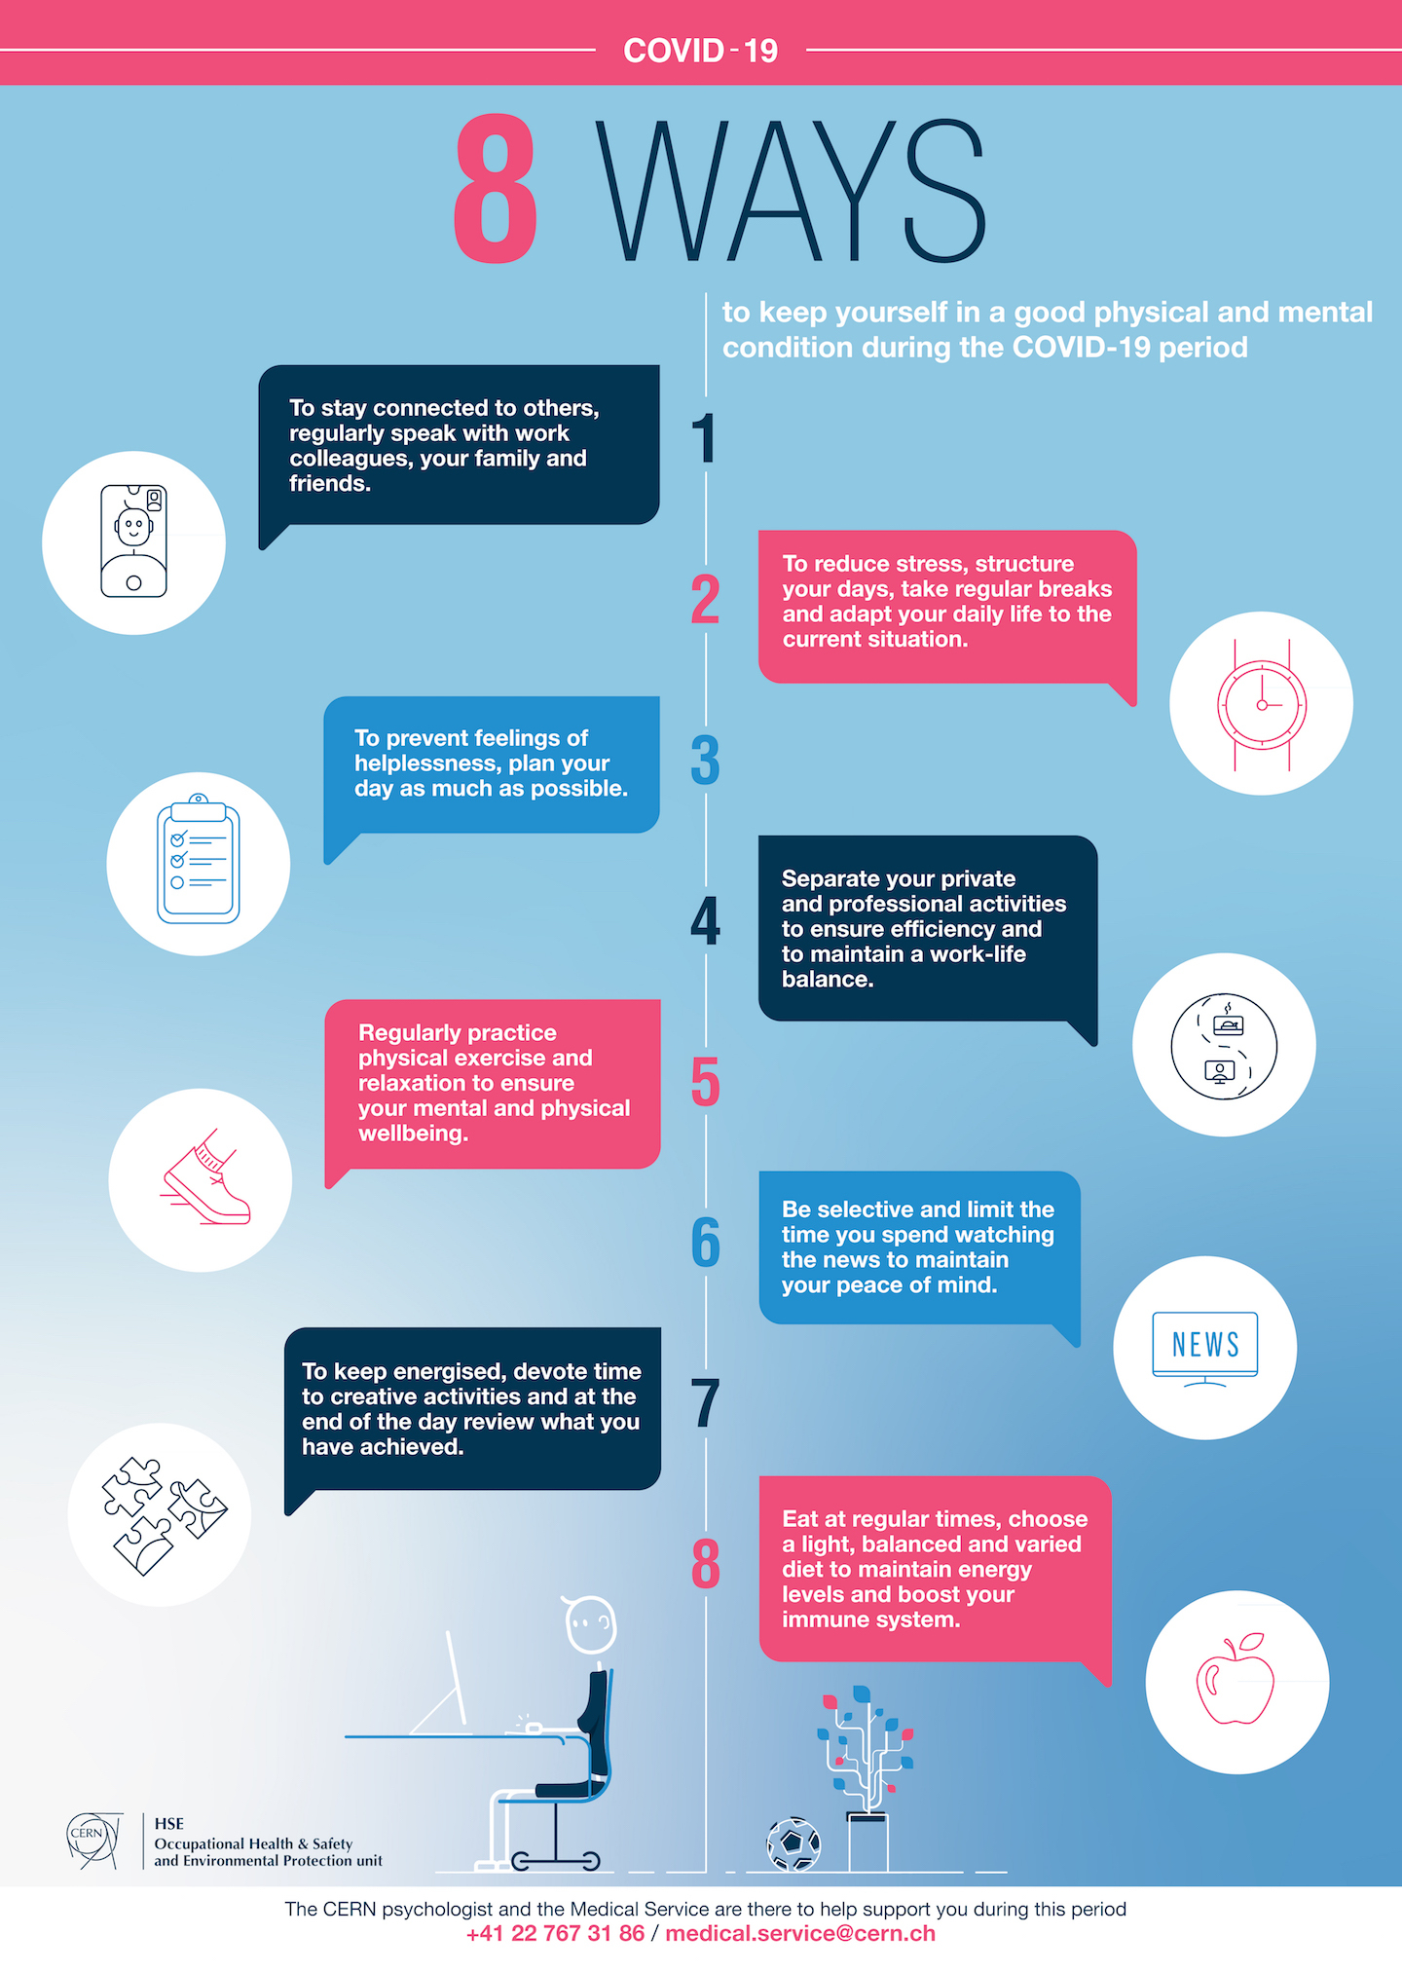

Slide 8
THANK YOU

Slide 9
FOR FURTHER ASSISTANCE CALL 9981009900

